Slide 1
CSCI Final Project
By: Anthony Zakszewski

Slide 2
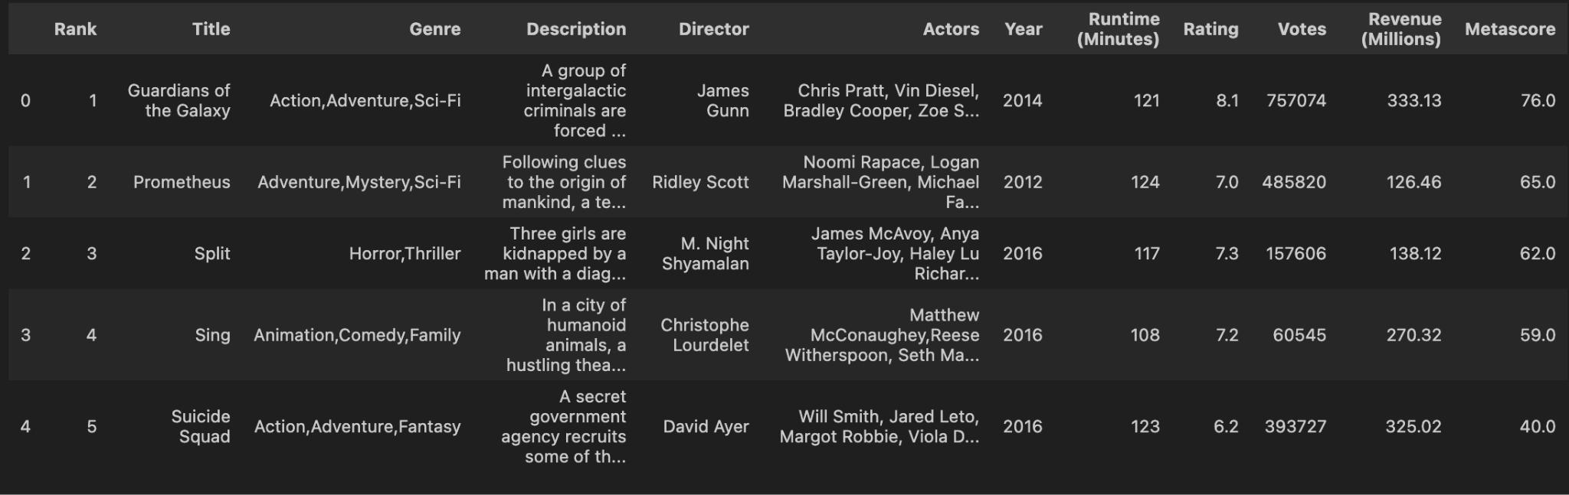
Introducing the Dataset
What is each variable?
Why are they important?
My hypothesis

Slide 3
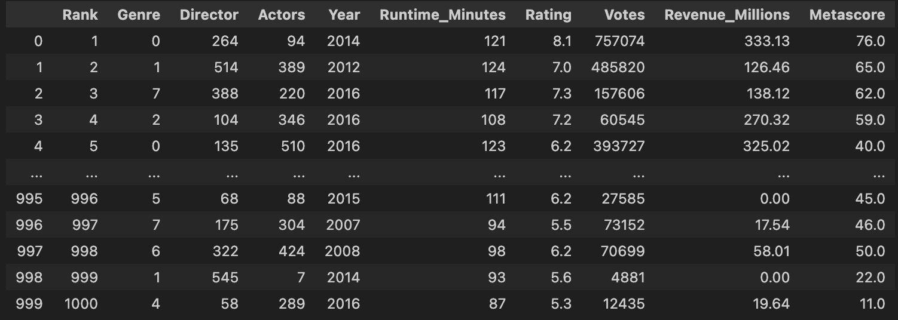
Cleaning the data
Removed title and description
Needed to change actors, directors, etc. to numerical
Removed nulls
Narrowed genre down to top ten then changed it to numerical

Slide 4
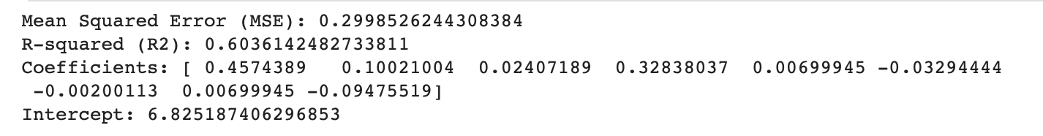
Multilinear Regression
Used all the variables and tested it against the rating, which was the predicted value
X = new_moviesData[["Metascore",'Runtime_Minutes', "Genre", 'Votes', 'Actors', 'Rank', 'Director', 'Actors', 'Revenue_Millions']]
y = new_moviesData["Rating"]

Slide 5
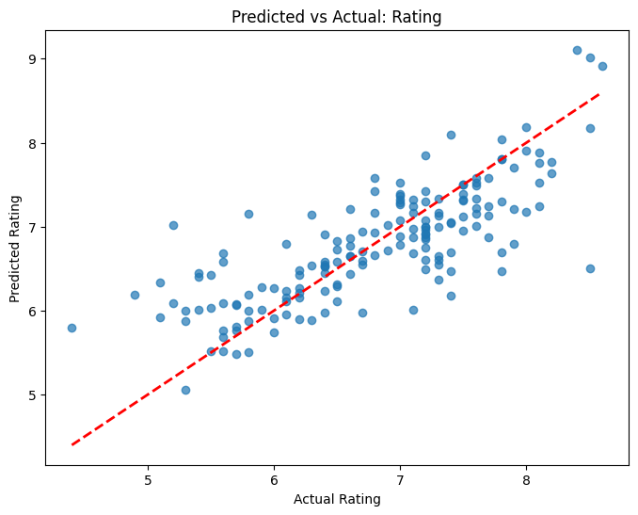
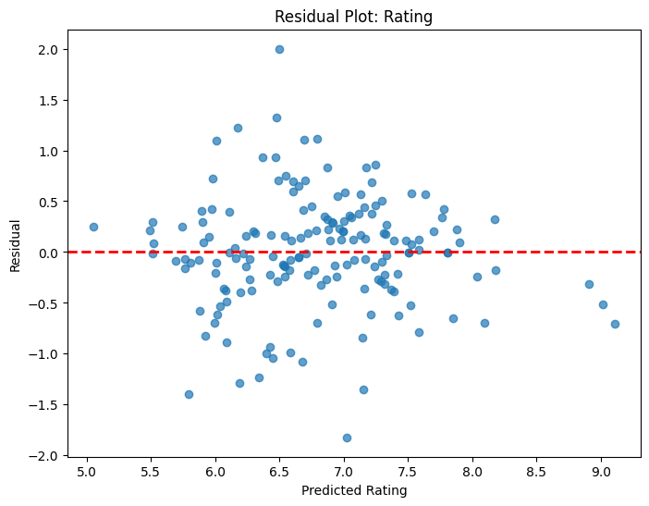

Slide 6
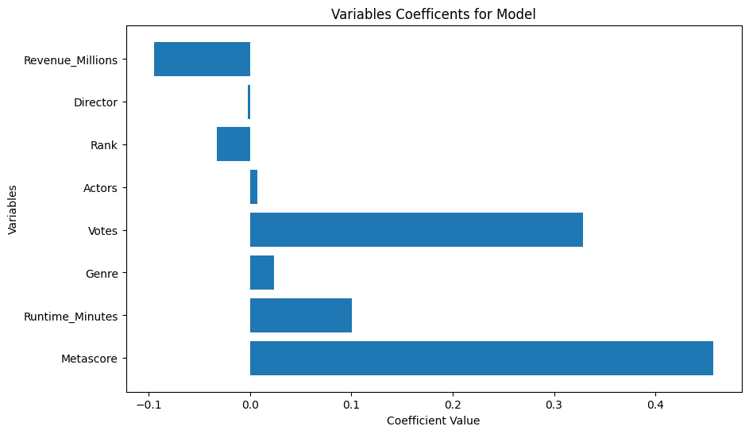

Slide 7
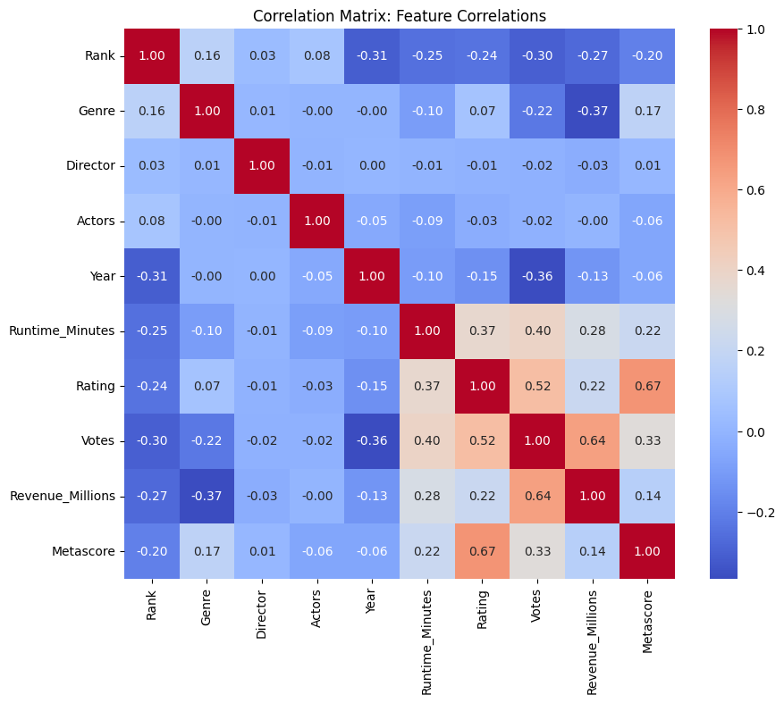

Slide 8
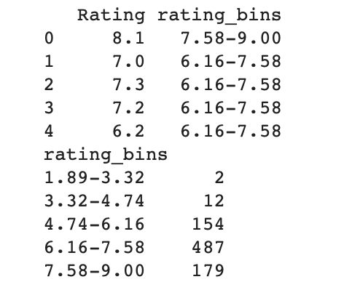
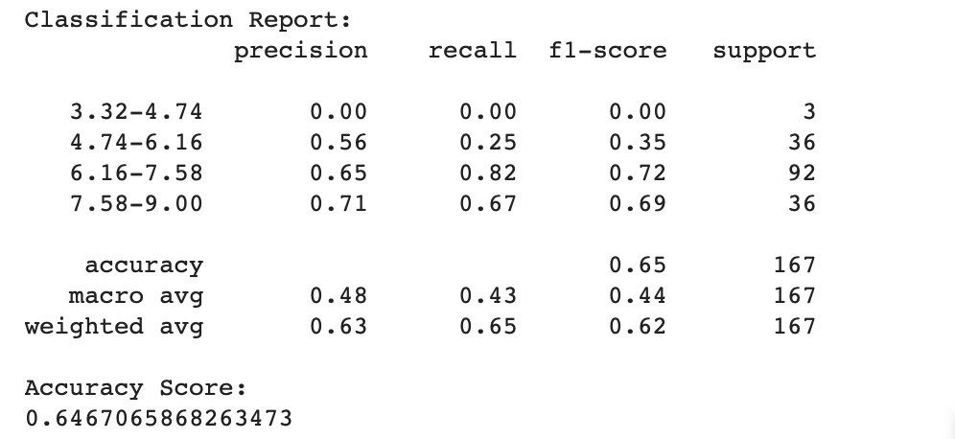
KNN
Because data is continuous, I have to bin the data
What is binning?

Slide 9
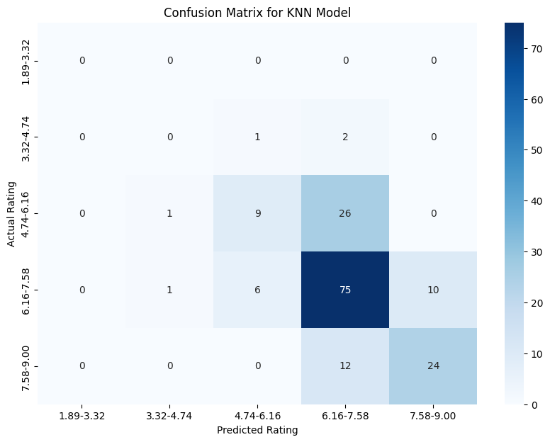

Slide 10
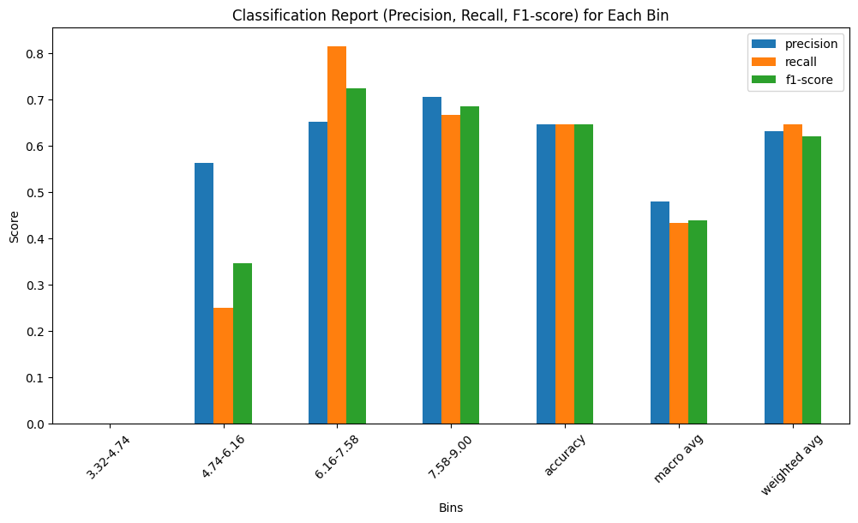

Slide 11
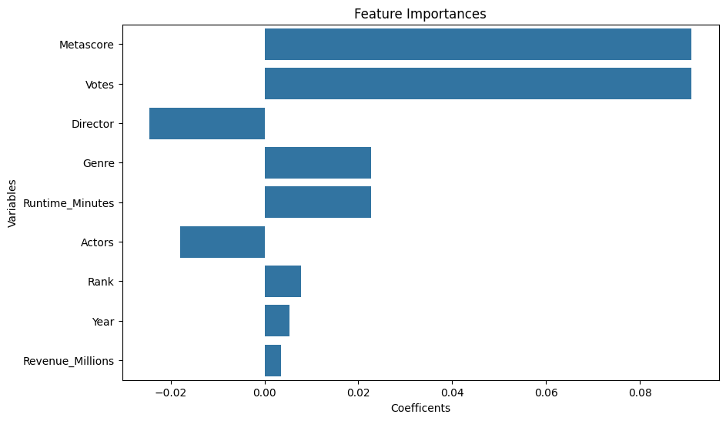

Slide 12
Takeaways
Hypothesis was somewhat true
Obviously these variables do have an impact
There are more variables that could be affecting the movie rating and some variables could have been dropped
Saw that votes and metascore have the highest positive impact when it comes to the rating
The Revenue has the highest negative impact when it comes to the rating
What would I revise for this project?

